Slide 1
RR-115.01
Program Summary:
The adaptive-reuse of a historic automobile dealership into a mixed-use property featuring 62 residences, street facing retail, 77 parking spaces, and 2 vehicular lifts
Program Statement:
The historic structure was built in 1951 as an urban automobile dealership, Stephens Buick, with sales, service, and repairs on the first and second floors and valet parking on the third, fourth, and fifth floors. The LEED certified, adaptive-reuse of the building has transformed the former dealership into a mixed-use, multi-family, property. The ground floor now includes a covered outdoor pedestrian entryway, lobby, mail, package and property management facilities. It also includes a gated vehicular vestibule and queuing area for the vehicular lifts. The former showroom has been transformed into 21,000 SF of continuous white-box retail space anchored by an iconic curvilinear cast-in-place concrete cantilevered canopy. The second, third, and fourth floors now contain 17 residences and approximately 20 parking spaces each. The fifth floor was constructed as a penthouse addition outside of the historic envelope; It includes 11 residences and 19 parking spaces. It also includes an indoor/outdoor community space with a swim spa pool, barbecue, exercise equipment, lounge, sauna, and steam facilities. The majority of residences include large terraces with commanding views of Downtown New Orleans. All of the floors are serviced by two passenger elevators, two vehicular lifts, and a bi-sorting chute for trash and recycling. The former partial basement contains a stormwater management system that detains and filters over 30,000 gallons of rain water.
Building Area: (sf)
156,000 GSF
Cost per Square Foot:
Confidential
Construction Cost
Confidential
Date of Completion:
11/15/2019

Slide 2
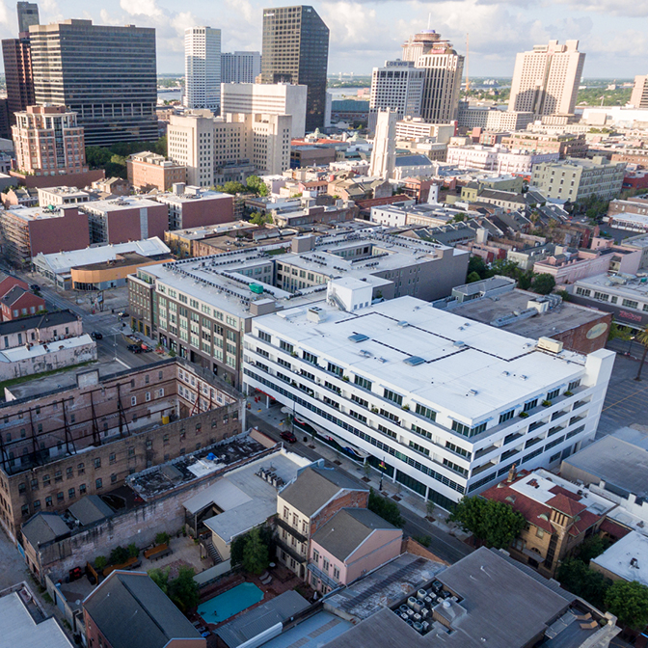
RR-115.02
AERIAL VIEW
The building is located within the Lafayette Square Historic District of New Orleans on Carondelet Street between St. Joseph and Julia Streets.
The site is located at the nexus of vibrant walkable neighborhoods including the Warehouse/Arts District, Central Business District, and South Market District all contributing to a walk score of 98.
The site is under the full control of the Historic Districts Landmarks Commission. The design was approved as appropriate for its historic context through a robust public process including review and approval by the State Historic Preservation Office and National Park Service.
Extensive participation by DBE contractors during construction was sought to meet social equity goals. The successful pursuit of this goal resulted in the approval of a restoration tax abatement.

Slide 3
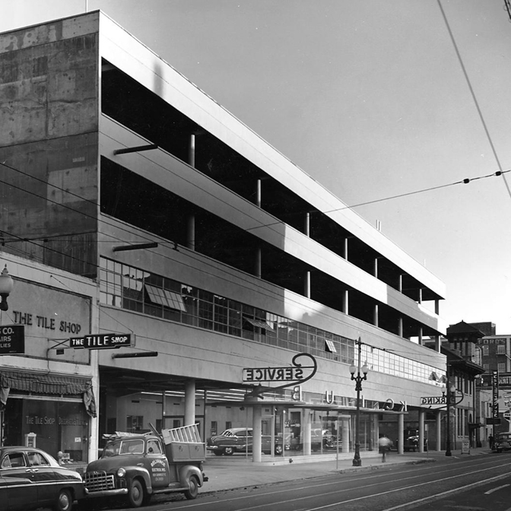
RR-115.03
HISTORIC LEGACY
The structure was originally designed by Freret & Wolf as one of the first urban automobile dealerships in the nation. The property included automobile sales, service, and repairs on the first and second floors and public valet parking for office workers on the third, fourth, and fifth floors.
The building employs a litany of Modernist elements that became synonymous with the commercial and institutional architecture of the era. The articulated, exposed, cast-in-place concrete structural system, metal-frame ribbon windows, and glass-block details, emphatically tie the building to the International Style. The adaptation of the building’s use and from vehicular to residential occupancy takes cues from the modernist movement, weaving a complimentary aesthetic and material palette into each space.

Slide 4
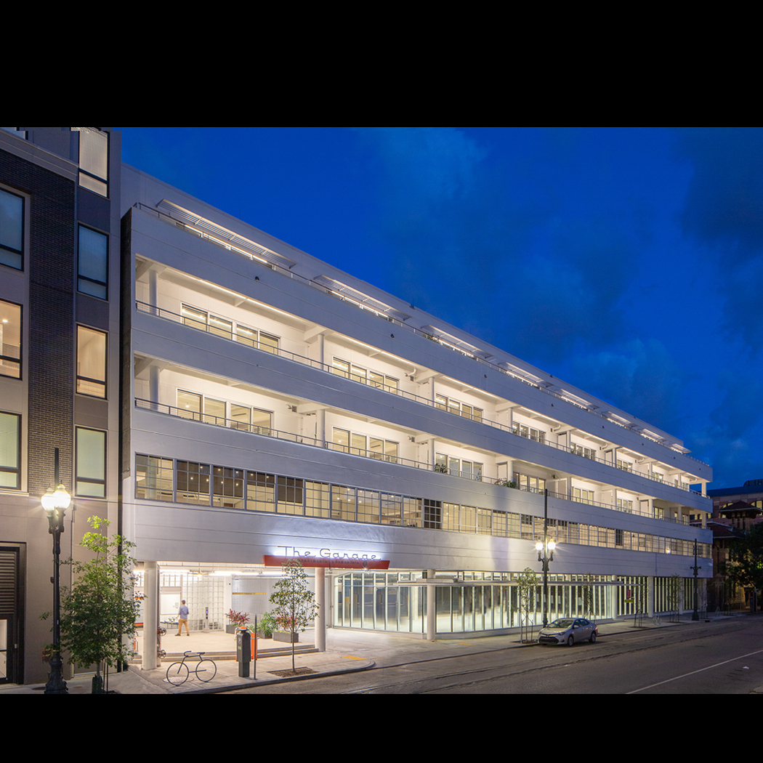
RR-115.04
View from Carondelet Street Facing Uptown
The street facing facade is a composition of historically sensitive new construction and the completely restored original structure.
Replica industrial ribbon windows with enhanced thermal, acoustic, and hurricane impact properties emphasize the horizontal on the second floor. A new stucco facade on the upper floors is recessed to maintain the aesthetics of the former parking levels and provide spacious balconies. Sixteen foot wide sliding doors centered on each column bay provide ample daylight and natural ventilation to the residences.

Slide 5
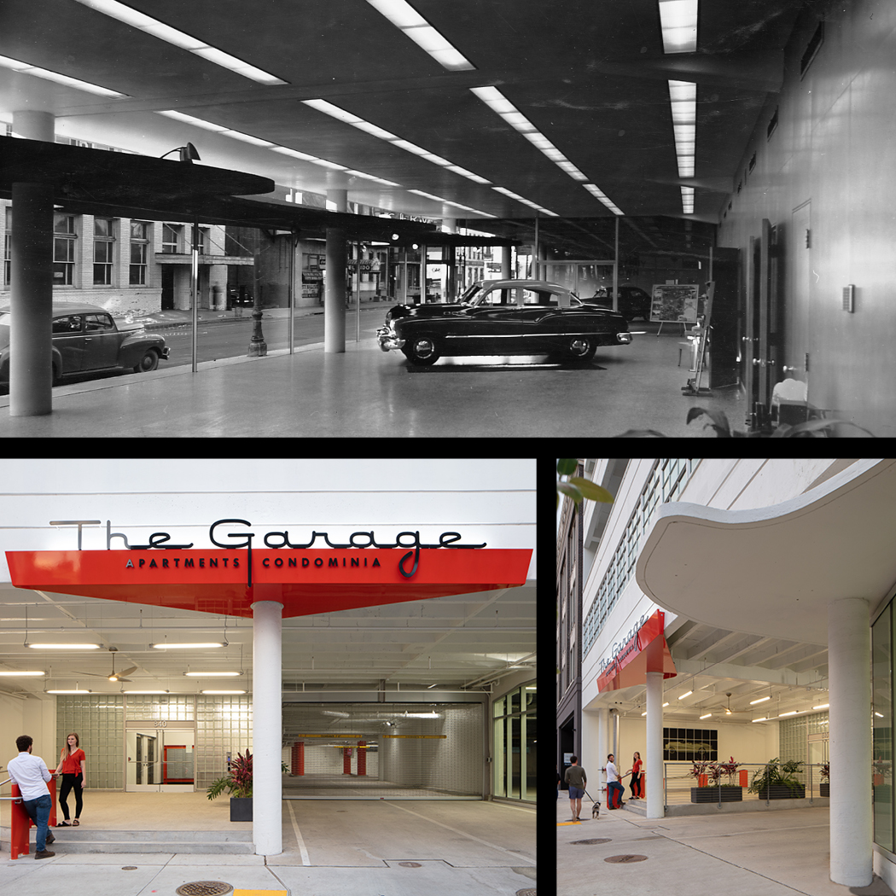
RR-115.05
DESIGN INSPIRATION
The property celebrates its historic legacy as an automobile dealership and parking garage through automotive inspired architectural interventions at multiple scales.
The restoration of existing finishes and sensitive integration of new building materials celebrate its mid-century modern, industrial aesthetic and heritage.

Slide 6
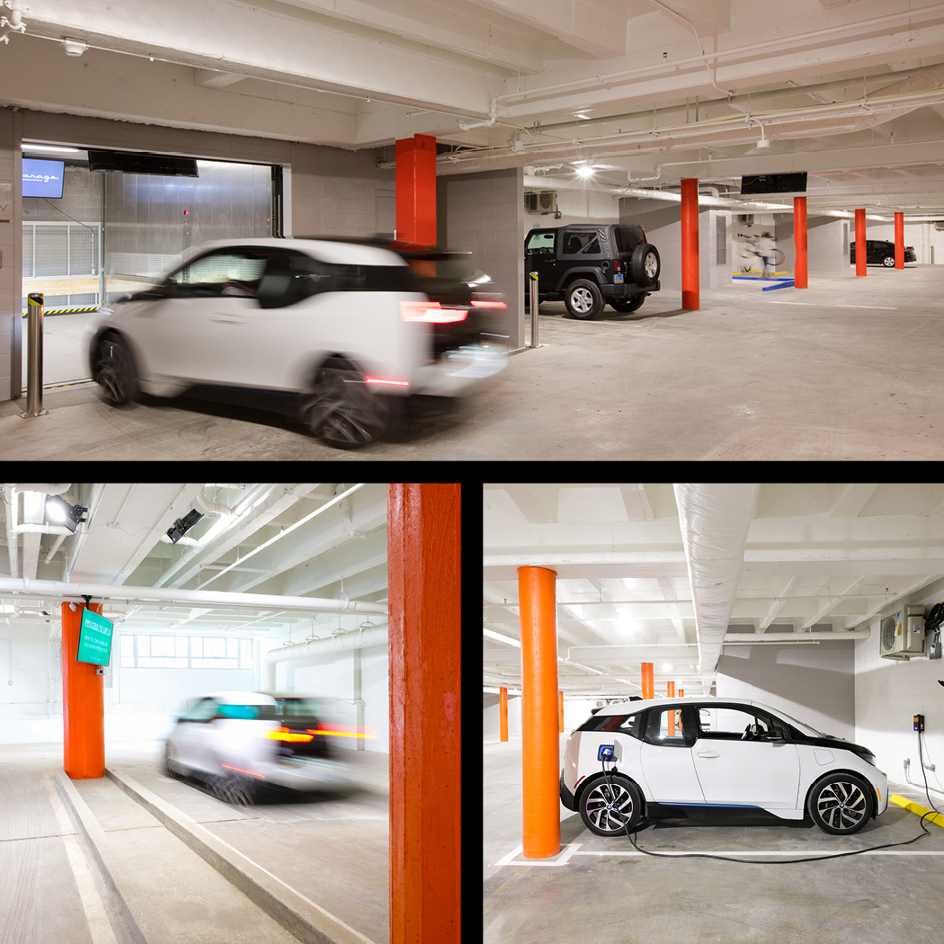
RR-115.06
VEHICULAR LIFTS
Two vehicular lifts stand out as the most unique feature inspired by the automobile. The automated elevators provide the conveniences of suburban living in an urban environment while maximizing the building’s usable square footage. Parking on each residential floor provides residents with private secure parking steps from their front doors.
Every vehicular parking space has been equipped with a bike rack that encourages residents to take advantage of an 89 Bike Score and utilize sustainable modes of transportation. To meet this goal the building is also equipped with multiple EV Charging Stations on every level.

Slide 7
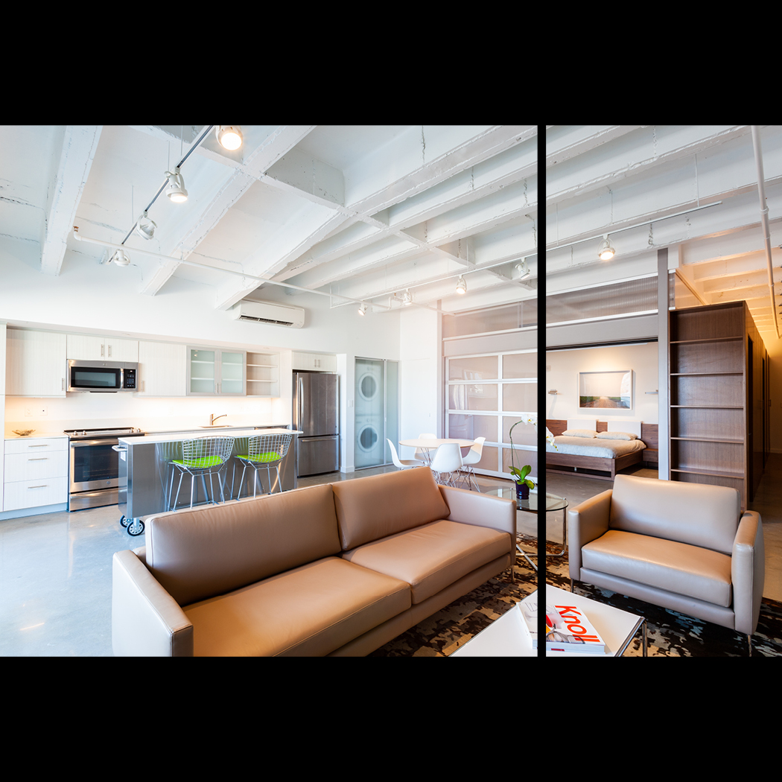
RR-115.07
AUTOMOTIVE INSPIRED DETAILS
Within the residences, a translucent, operable garage door serves as a movable partition that hearkens back to the building’s automotive legacy and provides flexibility for the residents in space planning and entertaining.
At a smaller scale, the kitchen islands were constructed from re-purposed mechanic-tool boxes on casters that offer ample storage, additional flexibility, and reinforce an automotive aesthetic.

Slide 8
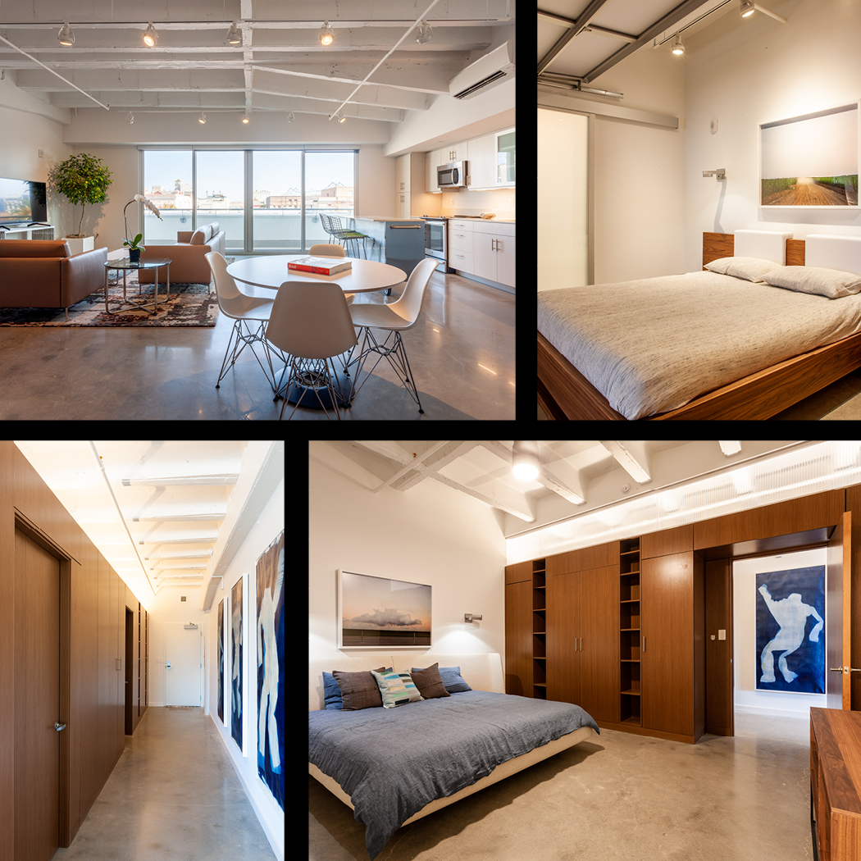
RR-115.08
MATERIAL AUTHENTICITY
The residences feature diamond polished concrete floors that draw their inspiration from the restored terrazzo flooring of the historic showroom. The concrete topping slab was poured over sound dampening materials in order to exceed acoustic separation requirements.
The cast in place concrete pan-joist structure has been restored and remains exposed. Attention is drawn to interventions like the removal of the curved parking ramps through the implementation of curved control joints that trace the former path of vehicular circulation.
Reconstituted walnut millwork “walls” bring warmth into the living spaces while providing ample storage and display space in every unit. The incorporation of this feature was inspired by the rich wood finish of the historic car showroom offices.
Translucent polycarbonate clerestories float over the millwork “walls” to draw natural light deep into the residences.

Slide 9
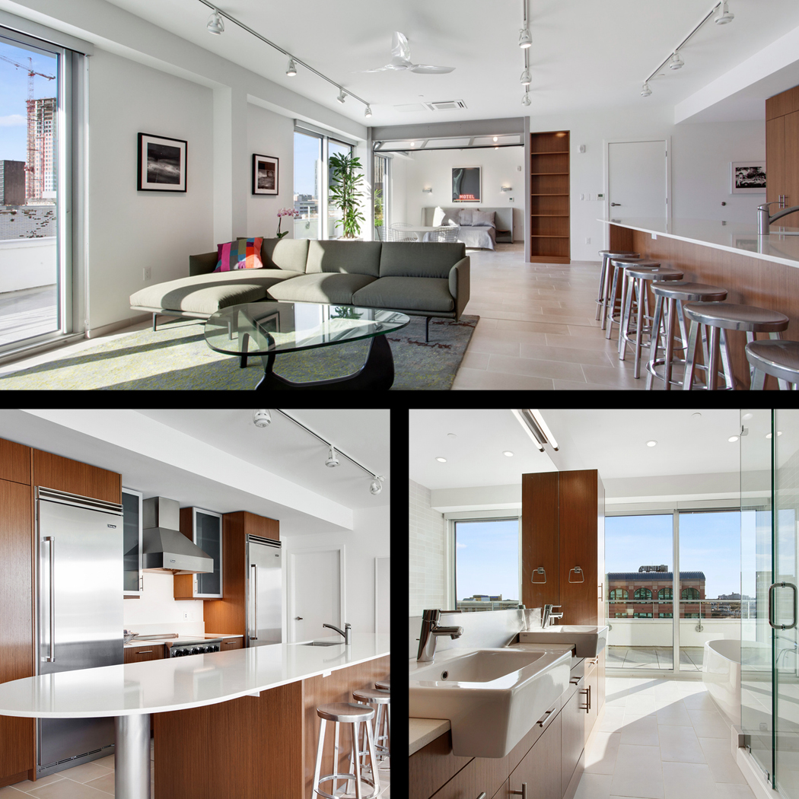
RR-115.09
PENTHOUSE RESIDENCES
A penthouse addition has been constructed above the historic structure.
The facade is set back further from the street then the lower levels to minimize the appearance of the new construction from the street and differentiate it from the historic structure.
Expansive sliding doors admit generous daylight, cooling breezes, and sweeping views into the residences. Each is shaded by aluminum louvers to minimize solar gain.
Refined finishes and fixtures distinguish the new construction from the adaptive-reuse of the historic building on the levels below.

Slide 10
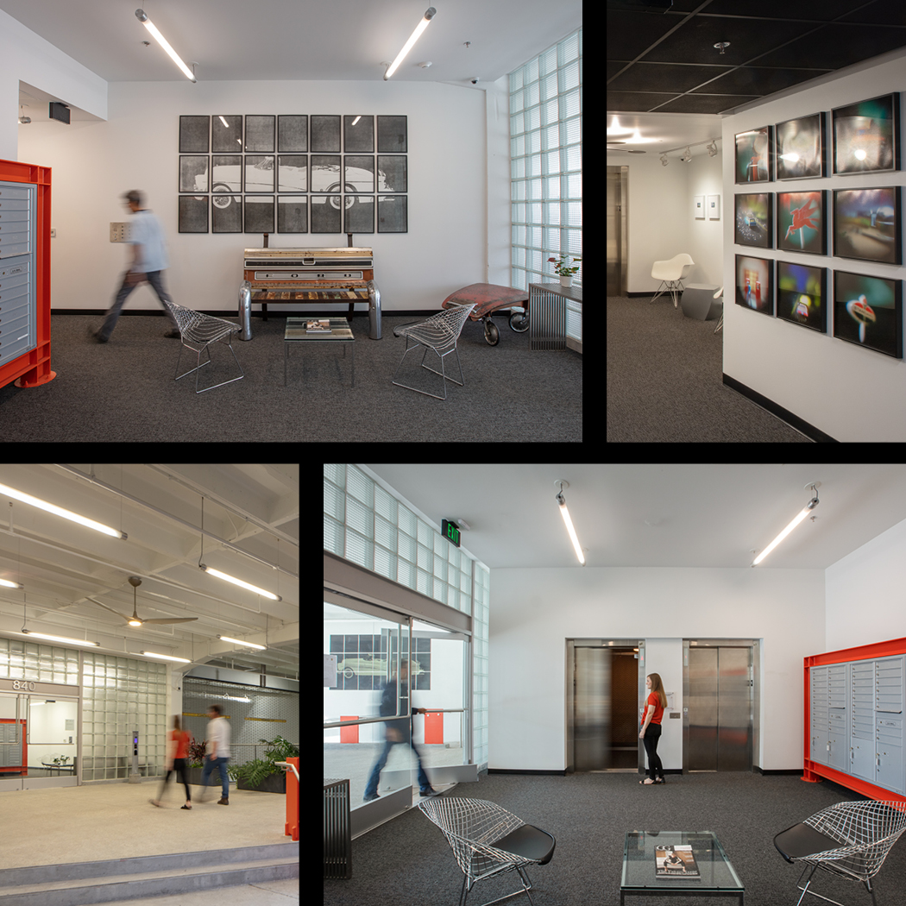
RR-115.10
HUMAN SCALED DESIGN
Careful attention was paid to ensuring that a property inspired by the automobile was appropriately scaled for its human inhabitants.
A historic glass-block wall was reconstructed with matching fluted glass blocks, and the addition of frameless, glass doors serves as the pedestrian entrance, providing access to stairs and elevators as well as mail, package and property management services.
As part of the design and development process, artists were commissioned to create a collection that explores and pays homage to the American automobile and its culture through lens based visual art.
The collection is on permanent display throughout the property, enlivening the public spaces and referencing the building’s origins.

Slide 11
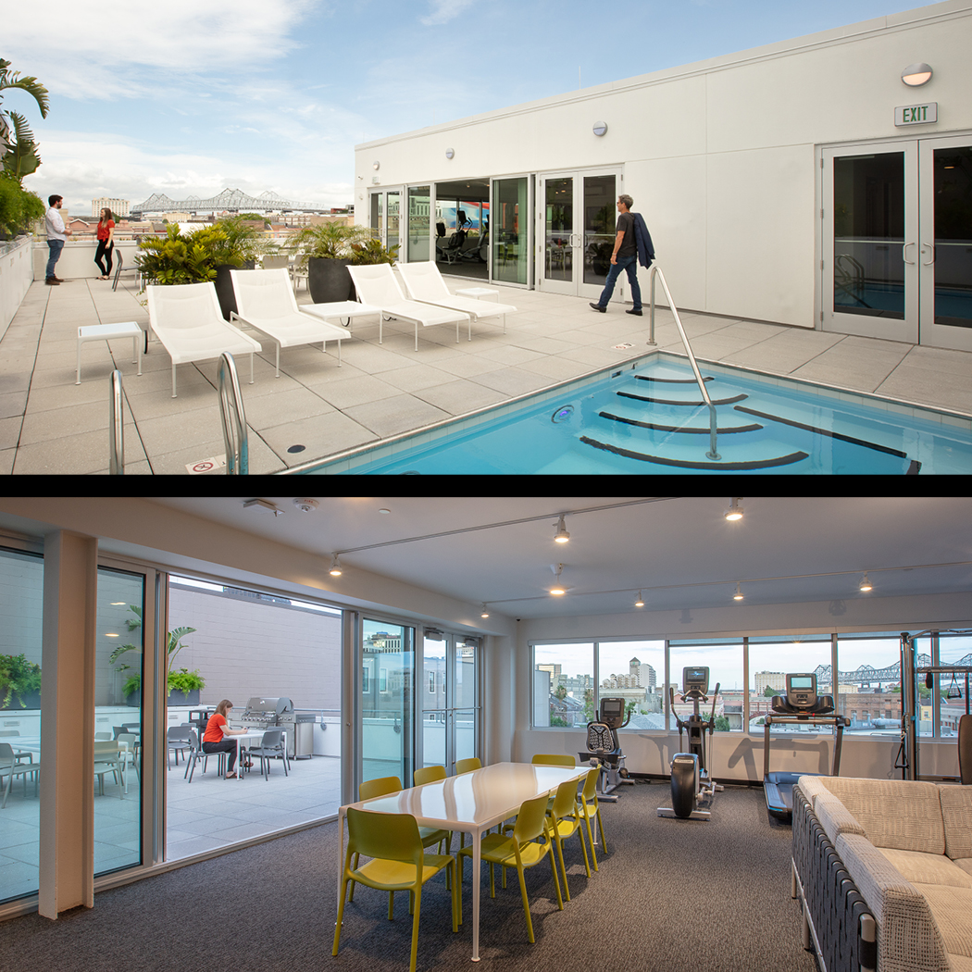
RR-115.11
DESIGNED FOR COMMUNITY
The penthouse level includes a flexible indoor-outdoor community space that fosters intra-personal interactions amongst the residents under commanding views of the Crescent City Connection.
Residents share a swim spa pool, barbeque, cardio and weight equipment, lounging and media areas, sauna and steam facilities, and a prep kitchen.

Slide 12
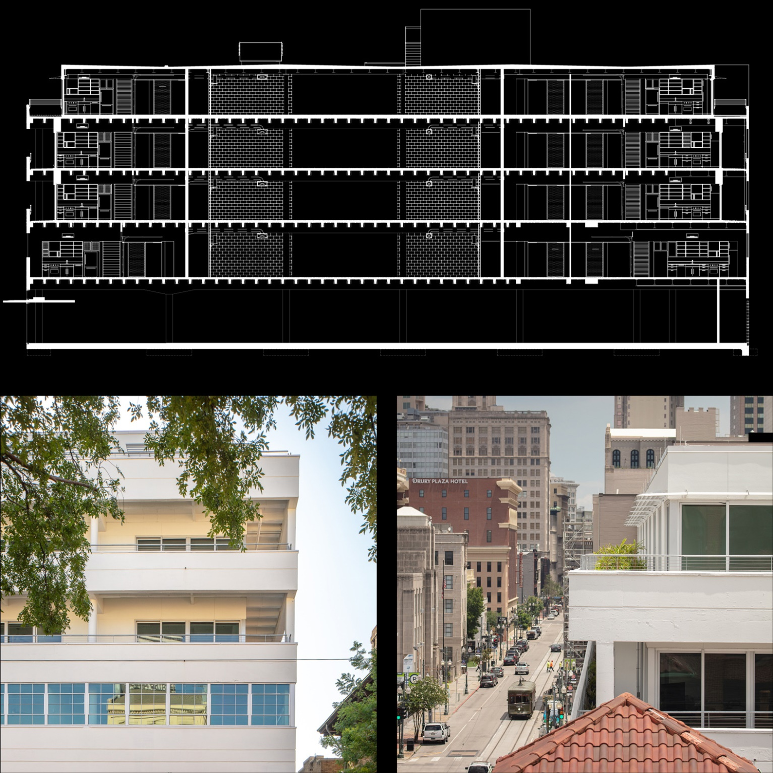
RR-115.12
DESIGNED FOR ENERGY AND WATER
Passive and active strategies allow the LEED certified building to achieve an EUI of 38 kBTU/sf. This represents a greater than 50% reduction from the AIA COTE benchmark for multifamily properties.
Expansive operable openings allow residents to avail themselves of natural ventilation during temperate seasons. When it is hotter, reflective cool white roofing, and shaded glazing minimize solar gain.
These passive strategies are supplemented by individually controlled mini-split HVAC systems that ensure thermal comfort and minimize energy use.
Hot water is provided to the property by a centralized recirculating gas fired system. Over 30,000 gallons of rain-water is detained and filtered by the stormwater management system.

Slide 13
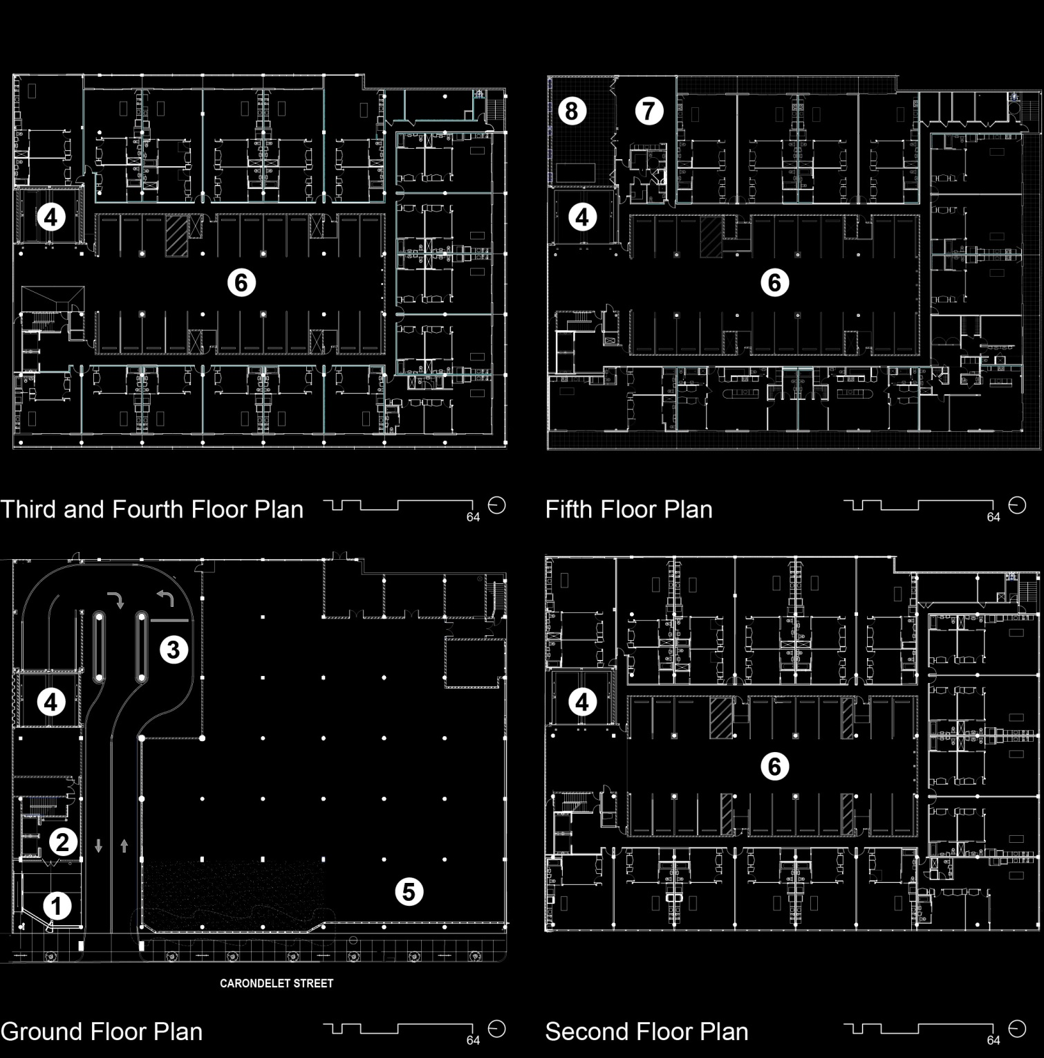
RR-115.13
FLOOR PLANS
1. Covered Entry
2. Pedestrian Lobby
3. Vehicular Queue
4. Vehicular Lifts
5. Commercial Tenant
6. Parking
7. Community Lounge
8. Pool Deck

Slide 14
Project Name:
The Garage
Project Location:
840 Carondelet Street, New Orleans, LA 70130
Owner/Client:
Stephens Garage Building LLC
Architect(s) of Record:
(names and addresses)
Wisznia | Architecture+Development
800 Common Street, Suite 200
New Orleans, LA 70112
Project Team:
Marcel Wisznia, AIA, Daniel Weiner, AIA, Michael Whitehead, Linda Burns, Mark Baum, AIA, Ralph Bradshaw, AIA, Simcha Ward, AIA, M. Haynes Johnston, Randy Hutchison, Jules Lagarde, AIA, Cameron Richard, AIA, William Tyler Sandlass, AIA, Sam Levin, Chris Daemmrich, David Morris, Megan Cook Bell, Keely Williams, Kelly Calhoun, Zach Gong, Bonnie Mitchell, John Chumba, Staci Rosenberg, Allison Schiller
Landscape Architect:
Evans and Lighter
Consultants:
Moses Engineers, Carubba Engineering, Inc., Southern Environmental Management & Specialties, Inc., LEAFF Environmental, LLC, US Eco Logic-Tex Energy Solutions, Terracon, IROS Elevator Design Services
General Contractor:
The Lemoine Company
Photographer(s):
(please list which specific slides get credited to each photographer(s) listed).
Neil Alexander: 4, 5 (lower), 6(upper), 10, 11, 12
David Armentor: 6(lower), 7, 8
Kelly Erin Kirschner: 9
Historic New Orleans Collection: 3, 5(upper)
RR-115.x

